Slide 1
Mid Sweden University
– a centre of knowledge and creativity

Slide 2
Mid Sweden University works for
Openness, kinship and diversity
Lifelong learning
Sustainable development
Education in close collaboration with working life
Distance learning at the forefront
High quality research
Close co-operation with the surrounding community
Notes:
• The fact that Mid Sweden University offers higher education at home contributes to more people having the opportunity to choose to study, without having to move. This in turn contributes to us in the region getting an increased proportion of skilled labor. • With the investment in the University of Children, Mid Sweden University establishes contact at an early age and can then arouse curiosity for higher studies and research.

Slide 3
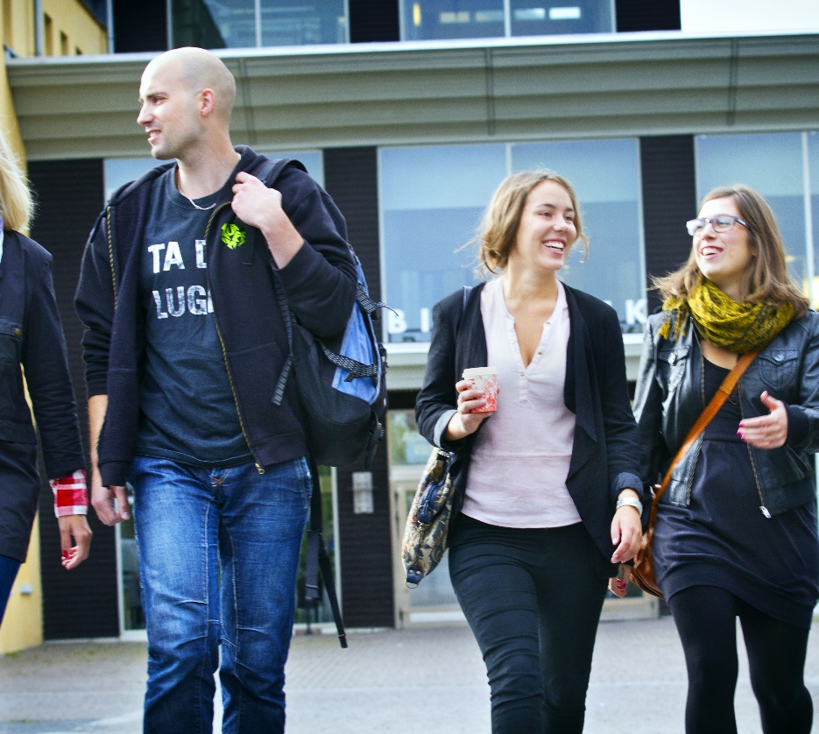
The university’s contribution to the region
A population increase of about 39,000 people in the last 30 years 84% of the students from Jämtland or Västernorrland counties remain in the region three years after graduation
Half of the total number of students remain in the region five years after graduation 85% of the students have a job one year after graduation
Notes:
• Mid Sweden University contributes to immigration and rejuvenation - half of those who graduated from Mid Sweden University remain in the region five years after graduation. The figure is higher compared to the reference universities. • Mid Sweden University reduces emigration - 84% of the students recruited from Jämtland and Västernorrland counties remain in the region three years after graduation. The figure is higher compared to the reference universities. • Studies at Mid Sweden University provide jobs - 85% are established in the labor market one year after graduation. • The investment in increased working life connection yields results - the proportion of alumni who have a weak or uncertain position in the labor market has decreased steadily since 2010
Source: SWECO 2020

Slide 4
Facts about Mid Sweden University

Slide 5
Mid Sweden University in numbers
26 000 students
508 courses
59 Bachelor’s programmes
38 Master’s programmes
1 200 employees
108 professors
Turnover just over SEK 1,2 billion
Notes:
Mid Sweden University in numbers
Number of students is based on the calendar year 2021 and includes both grant-rounding and non-grant-rounding students, rounded figure (contact Kenneth Johansson, ULS)
508 courses
59 Bachelor’s programmes
38 Master’s programmes
The number of employees is based on the number of individuals which is 1,120 and rounded to 1200
108 employed professors (individuals)
Turnover just over SEK 1,2 billion
The figures can be found in Mid Sweden University's latest annual report 2021.

Slide 6
Two campuses
Campus Sundsvall
Campus Östersund

Slide 7
The University Library in numbers 2021
707 916 usages of e-articles
34 054 loans (printed books)
92 883 visits (during pandemic)
3 551 participants in the university library’s workshops
Notes:
Mid Sweden University has its own libraries in Sundsvall and Östersund. The university library offers services to students, employees and the general public.
Year 2021
· 707 916 usages/downloads of e-articles / section e-books
· 34 054 lending of printed books
· 92 883 visits to the library premises (during pandemic)
· 3 551 participants in the University Library’s teaching / supervision
The University Library’s mission is to offer library services and learning support. The learning support includes making literature available, supporting information competence in the education and offering an inspiring study environment for students. In addition, there is a growing publishing support activity aimed at researchers. The library also has the function of a workplace library for all employees at the university and is open to the public.

Slide 8
INTERNAL AFFAIRS
UNIVERSITY BOARD
Organisation
VICE-CHANCELLOR/PRO-VICE-CHANCELLOR
FAHUMAN SCIENCES
CULTY OF
Economics, Geography, Law and Tourism
Humanities and Social sciences
Health Sciences
Nursing Sciences
Psychology and Social Work
Education
FACULTY OF SCIENCE, TECHNOLOGY AND MEDIA
Ecothecnology and Sustainable Building
Engineering
Electronics Design Computer and
System Science
Design
Information Systems
and Technology
Chemical Engineering
Mathematics and Science Education
Media and
Communication
Science
Natural Sciences
Quality Management
and Mechanical Engineering
ADMINISTRATION
Division of Communications
Division of Finance
Division of
Human Resources
Division of Infratructure
Division of Research and Educational support
Division of
Study Administration
University Library
The Vice-Chancellor’s
Office
University Library
Notes:
Mid Sweden University – organisation chart

Slide 9
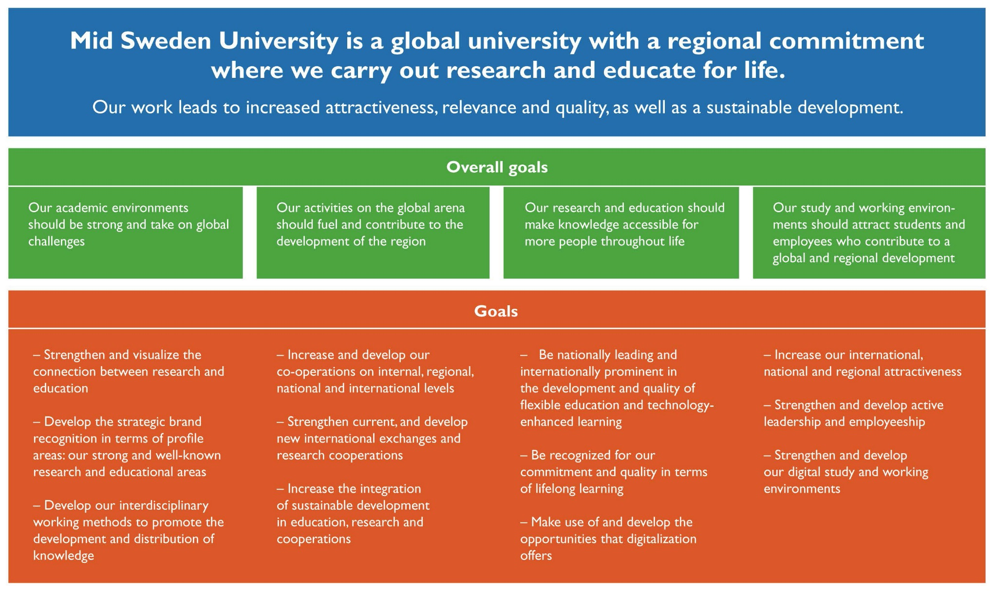
Strategy and vision
Notes:
Mid Sweden University's board decided in 2018 on a strategy for the period 2019-2023.
The strategy gives the business the conditions to plan and implement activities that contribute to common goals. Four general concepts have been identified which describe what Mid Sweden University wants to strengthen and what effects we want to achieve.
• Sustainable development - what we do must work not only today but also in the future. Our educations and our research must be consistently oriented towards building a resource-efficient, equal, gender-equal and sustainable society. We must actively and visibly contribute to the UN's global goals, in order to also contribute to a better future. We will strengthen the sustainability culture among Mid Sweden University's staff and students.
• Relevance - our educations and our research must be in demand because they take their natural starting point in societal processes. We will work interdisciplinary and with a connection to the outside world where we see our surroundings as a resource. We must benefit from and contribute to the development of our environment, both in the public sector and in business and civil society.
• Quality - everything we do must be permeated by high ambitions and recognized quality with knowledge development as a guiding star, whatever form it may take.
• Attractiveness - we must be a university that is noticeable and visible. Our youth, our ambitions and our flexibility are our strengths. We will expand and strengthen our networks and collaborations, and our recruitment will be even more clearly directed towards international contexts.

Slide 10
Vision
Mid Sweden University is a global university with regional involvement where we research and educate for life.
Our work leads to strengthened attractiveness, relevance and quality as well as to sustainable development.
Notes:
Figures 10–11 are enlargements of the vision and goals presented in Figure 9.

Slide 11
Overall goals
• Our academic environments are strong and address global challenges
• Our operations in the global arena drive and contribute to regional development
• Our research and education make knowledge available to more people throughout their lives
• Our study and work environment attracts students and employees who contribute to global and regional development
Notes:
Figures 10–11 are enlargements of the vision and goals presented in Figure 9.

Slide 12
Together we realize opportunities
At Mid Sweden University, we create an environment that makes it possible for students and researchers to achieve their goals together with us.
Effects we want now:
Sustainable Development
Social relevance
Recognized quality
Attractiveness through flexibility, strong collaborations and internationalization
Notes:
Four general concepts have been identified which describe what Mid Sweden University wants to strengthen and what effects we want to achieve.
• Sustainable development - what we do must work not only today but also in the future. Our educations and our research must be consistently oriented towards building a resource-efficient, equal, gender-equal and sustainable society. We must actively and visibly contribute to the UN's global goals, in order to also contribute to a better future. We will strengthen the sustainability culture among Mid Sweden University's staff and students.
• Relevance - our educations and our research must be in demand because they take their natural starting point in societal processes. We will work interdisciplinary and with a connection to the outside world where we see our surroundings as a resource. We must benefit from and contribute to the development of our environment, both in the public sector and in business and civil society.
• Quality - everything we do must be permeated by high ambitions and recognized quality with knowledge development as a guiding star, whatever form it may take.
• Attractiveness - we must be a university that is noticeable and visible. Our youth, our ambitions and our flexibility are our strengths. We will expand and strengthen our networks and collaborations, and our recruitment will be even more clearly directed towards international contexts.

Slide 13
Wide range of programmes and courses

Slide 14
Attractive courses and programmes of high quality – for lifelong learning
Notes:
Offer courses and programmes that:
are attractive and of high quality
we are able to recruit students to
are conducted in close collaboration with working life
offer a clear educational focus
are connected to research
Our education should be characterized by:
educational awareness
closeness
flexible type of instruction
international study environment
critical thinking and acquiring knowledge individually as key concepts

Slide 15
The distribution of students between the two campuses
A total number of about 26 000 students (2020)
Sundsvall, about 3,000
Östersund, about 3,000
The rest of the students take web-based courses without campus lessons.
Notes:
Number of individuals on the teaching forms Campus and Distance, 2020
Mid Sweden University has a total of approximately 20,000 students (calendar year 2020, including summer courses and non-grant-based programs)
Sundsvall, 2,938 (2020) - individuals studying on campus (distance education with meetings on campus is not included in this figure).
Östersund, 3,010 (2020) - individuals studying on campus (distance education with meetings on campus is not included in this figure).
Summer courses: 667 (2020)
Källa: Kenneth Johansson, ULS

Slide 16
Number of full-time equivalent (FTE)
Notes:
Number of full-time equivalent (FTE . During 2021: 8 635
Number of full-time equivalent students (yearly), with direct government funding. Full-time students, hst, is the number of students who are registered on a course opportunity multiplied by the course opportunity's point scope during a certain period divided by 60, ie. what number of students we would have if everyone read full-time throughout the year (person registrations converted to a full-time measure).

Slide 17
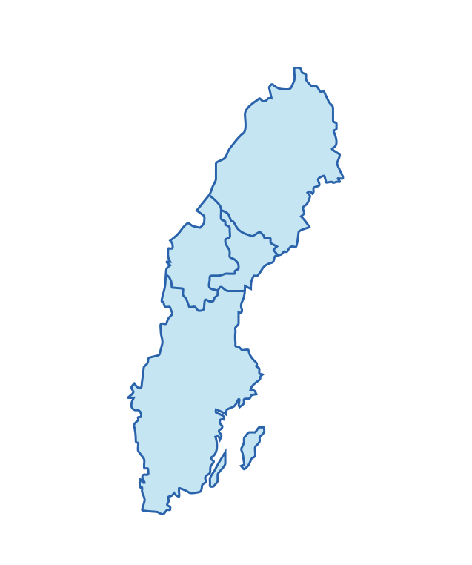
Where are the students from?
New students 2020/2021
Every fourth new student from Jämtland and Västernorrland choose Mid Sweden University
10% of the new students at Mid Sweden University come from Jämtland and Västernorrland.
Mid Sweden University recruits many students from Stockholm, Västra Götaland, Skåne and Uppsala.
4%
6%
26%
14%
13%
Notes:
New students at Mid Sweden University 2020/2021
The slide shows all new students (new at a higher education institute) who started studying at Mid Sweden University in 2020/2021. The numbers show where the students were registred at the time of the application. The total number of beginners were 11 318 (the year before, the number was 8 306 ), and out of these, 10 % came from the Mid Sweden University region.
Most of Mid Sweden University's beginners, students who registered at Mid Sweden University for the first time, come from Stockholm County, followed by Västra Götaland County, Skåne County and Uppsala County – all together 58 %.
Stockholm County 25,9 %
Västra Götaland County 14,1 %
Skåne County 12,7 %
Västernorrland County 5,7 %
Jämtland County 4,3 %
(For university beginners, you need to use a different basis, as the above figures refer to university beginners. The difference is that university beginners refer to those who are studying a university education somewhere for the first time, while university beginners refer to those who study a program at the specific university for the first time. thus having previously read elsewhere.)
Source: SCB

Slide 18
Programmes at Mid Sweden University
Access programme
Behavioural Sciences programmes
Master of science engineering programmes
Economy programmes
Sports programmes
Engineering programmes
Computer programmes
Programmes in Fine, Applied and Performing arts
Teacher Training programmes
Media programmes
Environment and Natural Sciences programmes
Programme in Psychology
Social Sciences programmes
Programme in Social Work
Languages and Humanities programmes
Tourism programmes
Health Sciences programmes

Slide 19
Development of applicants (first hand choice)
Notes:
Development of applicants, based on first hand choice
Source: Underlag till Mittuniversitetets årsredovisning 2021

Slide 20
Closeness to new knowledge by means of collaboration
Business councils
Field studies
Study visits
Internship and degree projects
Mentor programmes
Participation in networks and conferences
Innovation support
Miun Innovation supports student entrepreneurship
Notes:
All students at Mid Sweden University have the opportunity to receive advice on issues of idea development and entrepreneurship at Miun Innovation. It is part of the university's investment in working life and support for students' entry into the labor market.

Slide 21
Useful research of high quality

Slide 22
Research of high academic quality relevant to the surrounding society
Notes:
Aims according to the research strategy:
• Strengthen and make visible the connection between research and education
• Develop profiled, strong and well-known research and education areas
• Develop our disciplinary approaches to promote knowledge development and dissemination
• Increase and develop our collaboration internally, regionally, nationally and internationally
• Strengthen existing and develop new international exchanges and research collaborations
• Increase the integration of sustainable development in education, research and collaboration

Slide 23
Development of research 2005–2021
Government research funding (SEK Million)
PhD Students (number)
External funding for research (SEK Million)
Professors (number)
Notes:
The development of our research in 2005–2021.
Source: Mid Sweden University Annual Report
2021.

Slide 24
Research at Mid Sweden University
is partly organized in research centres and partly in subject research and research groups
is, to a great extent, conducted and made use of in direct collaboration with external partners
has a clear connection to first-cycle programmes and courses
Notes:
The center formations are arenas for collaboration and spearheads in their research areas. A forum is a university-wide and multidisciplinary work unit that serves as a meeting place for researchers and stakeholders.

Slide 25
Profiled research areas
Mid Sweden University has eight different research centres. Several of them ar worls leading within their fields of research.
The centres also works as platforms for cooperation with financiers and other parties.

Slide 26
Research centres
CER – conducts industry-oriented research on economic relations of individuals and companies in the banking, insurance, pension, audit and real estate industries
DEMICOM – conducts research on democracy and communication in the digital community
ETOUR – develops and communicates scientific knowledge about tourism and travel
FSCN – conducts world-leading research in collaboration with the industry in subprocesses from forest to paper, biomaterial and new products

Slide 27
Research centres
NVC – research in winter sports/skiing, performance and health
RCR – develops and communicates knowledge about risk, crisis and security
Sports Tech Research Centre – research in sports technology and products for outdoor and sports activities as well as products meeting the demands of people with disabilities
STC – develops sensor-based systems and services in electronics and computer science with a focus on industrial IT and digital services

Slide 28
Subject research
Research connected to big and important first-cycle educational areas
A great part of subject research deals with the welfare sector, for example school, care and nursing
Notes:
Subject research
Within Mid Sweden University, research is conducted in all scientific areas. This leads to a broad range of research projects and qualified researchers. One example is research related to big and important first-cycle educational areas. Since most researchers also teach, first-and second-cycle students get a natural insight into and a connection to the research conducted at Mid Sweden University in a certain subject.

Slide 29
Utilization of research
Innovation support for researchers
Commercialization of research and knowledge
Mid Sweden University is part of an innovation office commissioned by the state - the innovation office Fyrklövern

Slide 30
Mid Sweden University 2021 – Infographics

Slide 31
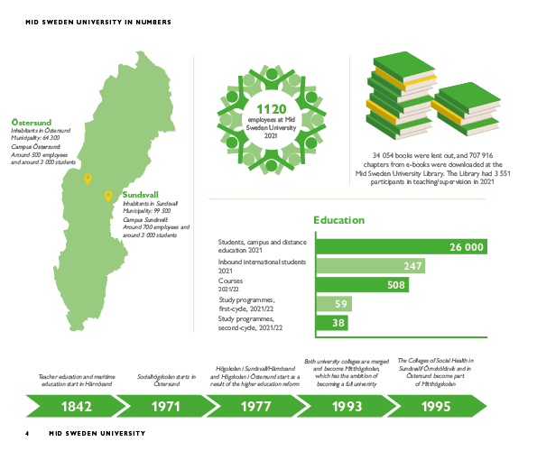

Slide 32
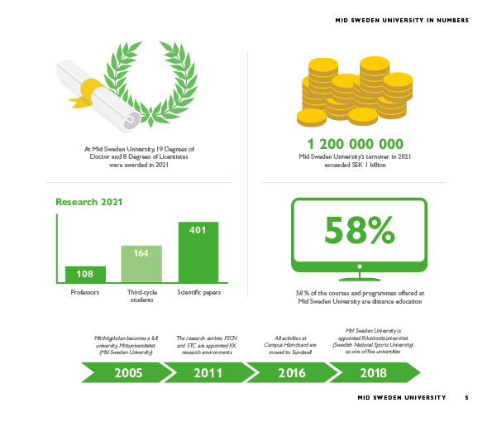

Slide 33
Contact Phone +46 10 142 80 00 E-mail kontakt@miun.se Web miun.se

