Slide 1

Mid Sweden University
– a hotbed of knowledge and creativity

Slide 2

Mid Sweden University works for:
Openness, kinship
and diversity
Education in close collaboration with working life
High quality research
Close co-operation with the surrounding community

Slide 3
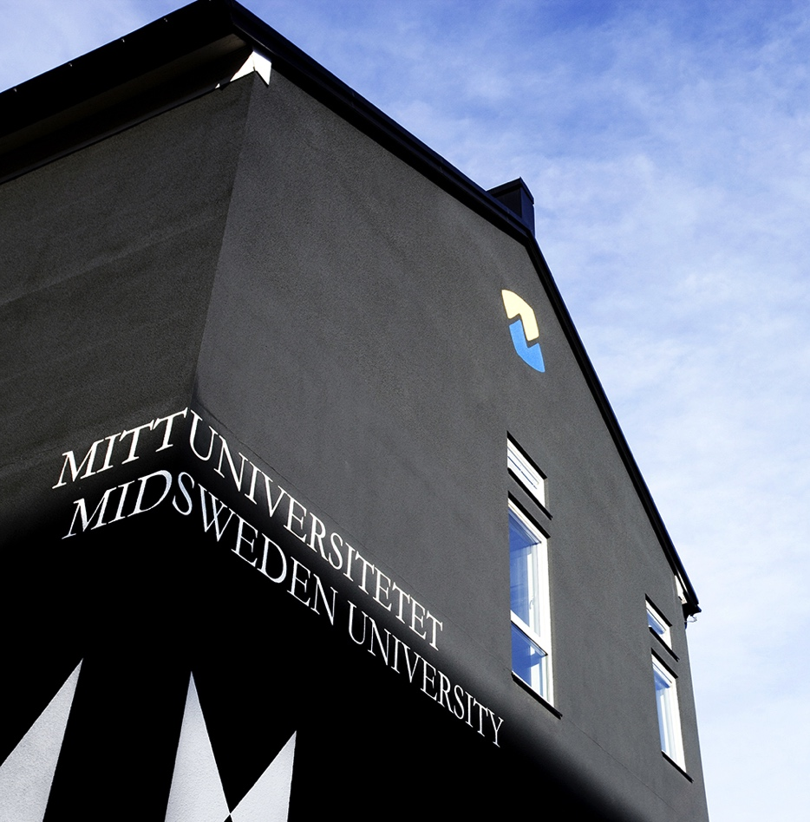
The university’s contribution to the region
After finishing their studies, 49% of students remain in Jämtland and Västernorrland
An increase of approximately 39 000 inhabitants during the last 30 years
Every month approximately 1,5 companies are started by our employees and students with help from the university’s innovation office
Notes:
The numbers are based on the report by Sweco: ”Regionala effekter av Mittuniversitetet: En studie av universitetets betydelse för utbildningsnivå, kompetensförsörjning, sysselsättning och tillväxt” from December 2016.

Slide 4
Facts about
Mid Sweden University

Slide 5
Mid Sweden University in numbers
13 000 students
345 courses
47 Bachelor’s programmes
37 Master’s programmes
1000 employees
85 professors
Turnover SEK 966 Millions
Notes:
Mid Sweden University in numbers
13 000 The number of students counts students with direct government funding in 2016/2017
345 courses (in round figures, 2018/2019)
47 Bachelor’s programmes (2018/2019)
37 Master’s programmes (2018/2019)
1000 The number of employees is based on individuals (not the work year equivalent, which is 853)
85 employed professors in 2017
Turnover SEK 966 Millions in 2017
Please note that these are round figures. Most of the exact numbers can be found in the Mid Sweden University Annual Report from 2017.

Slide 6
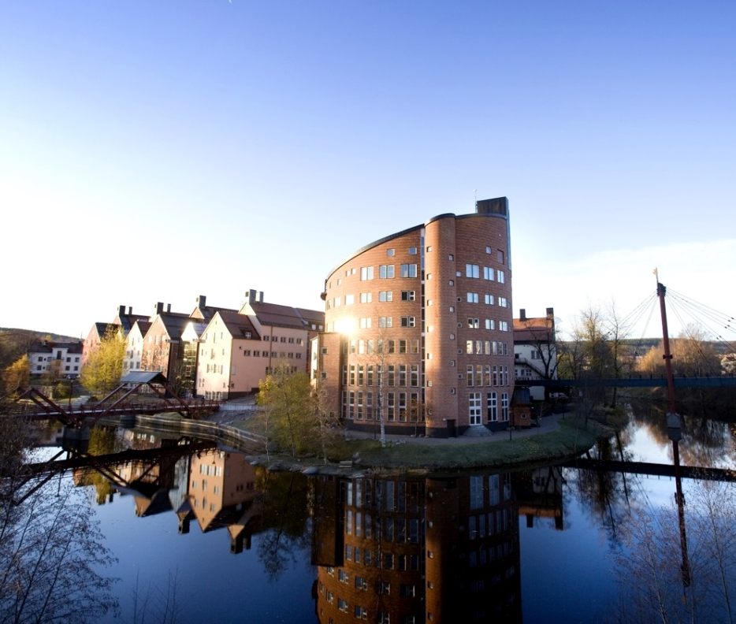

Two campuses
Campus Sundsvall
Campus Östersund

Slide 7

The University Library in numbers
620 860 e-articles/downloaded chapters in e-books
120 267 loans (printed books)
37 300 answered questions via chatt, e-mail and the informationdesk
266 848 visits
307 212 visits on the website
3 900 participants in the university library’s workshops
Notes:
Mid Sweden University has two libraries, one in Sundsvall and one in Östersund. The libraries offer their services to students and employees and to the public.
2017
620 860 e-articles/ downloaded chapters in e-books
120 267 loans (printed books)
37 300 answered questions via chatt, e-mail and informationsdesk
266 848 visits
307 212 visits on the website
3 900 participants in the university library’s workshops
*Tidigare år har UB även räknat med besök av allmänheten i Sambibliotekets lokaler Härnösand, därav minskningen i antal fysiska besök 2017.
Universitetsbiblioteket består av fyra avdelningar och ett kansli. UB:s uppdrag är att i vid bemärkelse bedriva lärandestöd riktad till studenter och lärare. Lärandestödet innefattar tillgängliggörande av litteratur, att stödja informationskompetens i utbildningen och att erbjuda ett pedagogiskt/didaktiskt stöd till lärare samt en inspirerande studiemiljö för studenter. Till detta kommer en växande publiceringsstödsverksamhet som riktar sig mot forskare. Biblioteket har också funktionen av ett arbetsplatsbibliotek för samtliga anställda vid lärosätet samt är öppet för allmänheten.

Slide 8
Organisation
INTERNAL AFFAIRS
UNIVERSITY BOARD
VICE-CHANCELLOR/PRO-VICE-CHANCELLOR
FACULTY OF
HUMAN SCIENCES
Business, Economics
and Law
Humanities
Health Sciences
Nursing Sciences
Psychology
Social Sciences
Social Work
Tourism Studies
and Geography
Education
FACULTY OF SCIENCE, TECHNOLOGY AND MEDIA
Ecothecnolog and
Sustainable Building
Engineering
Electronics Design
Computer and
System Science
Design
Information Systems
and Technology
Chemical Engineering
Mathematics and Science Education
Media and
Communication
Science
Natural Sciences
Quality Management
and Mechanical Engineering
ADMINISTRATION
Division of Communications
Division of Finance
Division of Infrastructure
Division of
Human Resources
Division of Research and Educational Support
Division of
Study Administration
Student and
University Services
The Vice-Chancellor’s
Office
University Library
Notes:
Mid Sweden University – organisation chart

Slide 9
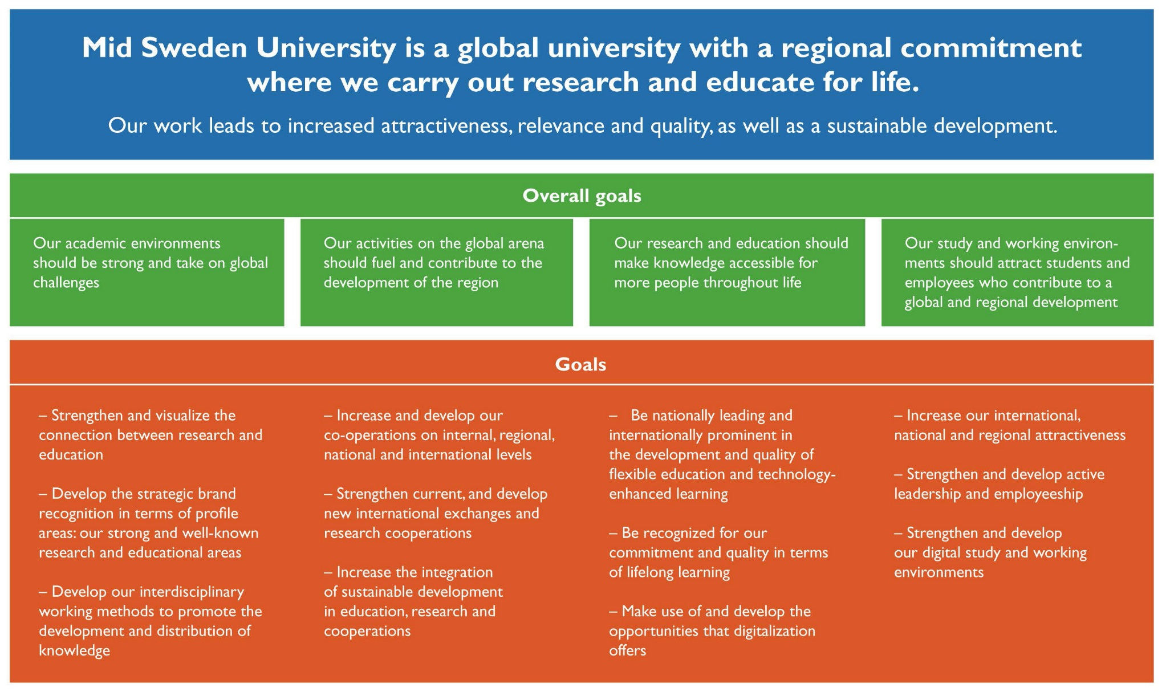
Strategy and vision
Notes:
In 2009, the Mid Sweden University Board decided on a development plan for the period 2009-2012. In 2014, it was decided to extend the plan to 2016, making only minor, above all editorial changes.
The plan determines the direction of the Mid Sweden University activities and it is accompanied by strategies and action plans. During 2010, a new educational strategy was produced for the period 2011-2015 (and after that, it was extended until 2017). The focus area of the strategy is to reach excellence in the areas of e-learning and cooperation with trade and industry. These are areas where Mid Sweden University has a long tradition and good preconditions to reach the goals. They are also areas sought after by the students and therefore, they generate quality and attractivity. According to the educational strategy, Mid Sweden University should continue to develop the courses and programmes offered to meet the demand of the surrounding world. There should be a clear focus on the programmes and courses that are unique at Mid Sweden University and there is a suggestion to make the Summer University a brand. Seeking partnerships with other higher education institutes is also important.
Also in terms of research, cooperation with the surrounding world is emphasized in the development plan: We should aim at coproduction with external actors and an increased share of external funding. During 2011, a research strategy was produced and in 2013, a strategy for the prerequisites of the activities was determined.

Slide 10
Wide range of programmes and courses

Slide 11

Attractive courses and programmes of high quality
Notes:
Offer courses and programmes that:
are attractive and of high quality
we are able to recruit students to
are conducted in close collaboration with working life
offer a clear educational focus
are connected to research
Our education should be characterized by:
educational awareness
closeness
flexible type of instruction
international study environment
critical thinking and acquiring knowledge individually as key concepts

Slide 12

Realizing opportunities
We are an excellent stepping stone – an environent that makes it possible for students and researchers to reach their goals together with us.
Notes:
In Sweden, there are more than 50 universities and university colleges. Some are specialized, but most of them offer a broad range of exciting programmes and courses as well as important research. It is not always easy to find out what the difference is between the universities, and still, it is important to be able to do just that – especially if you want to recruit a certain number of students and create viable research environments, and also if you want to attract business partners and qualified staff.
If we were to sum up our activities and try to describe the core in a short and accessible way, to convey an image of Mid Sweden University to the surrounding world, we would start with the goal the individuals; the student, the researcher, the employee, and their reasons for coming to Mid Sweden University. That is our starting point when we working strategically with the image of what we are and what we stand for, i.e. the brand Mid Sweden University.

Slide 13
Distribution of students between the campuses
A total number of about 13 000 students (2016/2017)
Sundsvall, about 4 200
Östersund, about 2 800
The rest of the students take web-based courses without campus lessons.
Notes:
The number of individuals including campus and distance education students, but not IT-distance students, in 2016/2017. (education with direct government funding, not contract education).
Source: ULS

Slide 14
Number of full-time equivalent (FTE)
Notes:
The number of full-time equivalent students (yearly), with direct government funding.

Slide 15
Where are the students from?
New students 2016/2017
Every third new student from Jämtland and Västernorrland choose Mid Sweden University
16% of the new students at Mid Sweden University come from Jämtland and Västernorrland.
Mid Sweden University recruits many students from Stockholm, Västra Götaland, Skåne and Gävleborg.
6%
10%
5%
23%
13%
11%
Notes:
New students at Mid Sweden University 2016/2017
The slide shows all new students (new at a higher education institute) who started studying at Mid Sweden University in 2016/2017. The numbers show where the students were registred at the time of the application. The total number of beginners were 6397 (last year, the number was 6893), and out of these, 16% came from the Mid Sweden University region.
Every third new student from Jämtland and Västernorrland choose Mid Sweden University.
16% coming from the Mid Sweden University region is the same share as last year but a clear decrease in comparison with the early 21 century years (42% in 2002/2003 and 35% in 2003/2004, but 29% in 2004/2005). It is clear to see that Mid Sweden University recruits students on a national level. The range of distance education courses and web-based courses is likely to be of importance for this development.
Source: SCB, UF0205 och Swecos rapport ” Regionala effekter av Mittuniversitetet: En studie av universitetets betydelse för utbildningsnivå, kompetensförsörjning, sysselsättning och tillväxt” from December 2016.

Slide 16
Programmes at Mid Sweden University
Access programme
Behavioural
Sciences programmes
Civil Engineering programmes
Economy programmes
Sports programmes
Engineering programmes
Computer programmes
Programmes in Fine,
Applied and Performing arts
Teacher Training programmes
Media programmes
Environment and Natural Sciences programmes
Programme in Psychology
Social Sciences programmes
Programme in Social Work
Languages and
Humanities programmes
Tourism programmes
Health Sciences programmes

Slide 17
Development of applicants (first hand choice)
Notes:
Development of applicants, based on first hand choice
Source: Underlag till Mittuniversitetets årsredovisning 2017/UHR-statistik

Slide 18

Closeness to new knowledge by means of collaboration
Business councils
Field studies
Study visits
Internship and degree projects
Participation in networks and conferences
Innovation support
Supports student entrepreneurship

Slide 19
Useful research of high quality

Slide 20
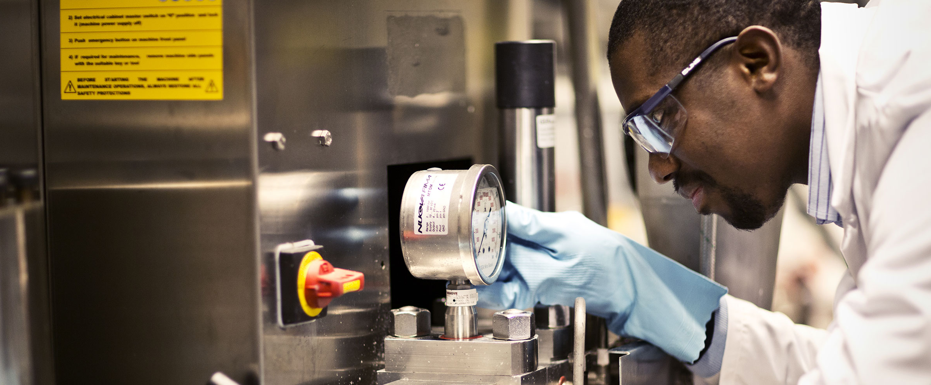
Research of high academic quality relevant to the surrounding society
Notes:
Aims according to the research strategy:
high academic quality
relevant to the surrounding society
coproduction with external partners
increased share of external funding
international cooperation
Internationally leading in our
profiled areas

Slide 21
Development of research 2005–2017
PhD Students (number)
Government research funding (SEK Million)
External funding for research
(SEK Million)
Professors (number)
Notes:
The development of our research in 2005–2017.
Source: Mid Sweden University Annual Report
2017.

Slide 22
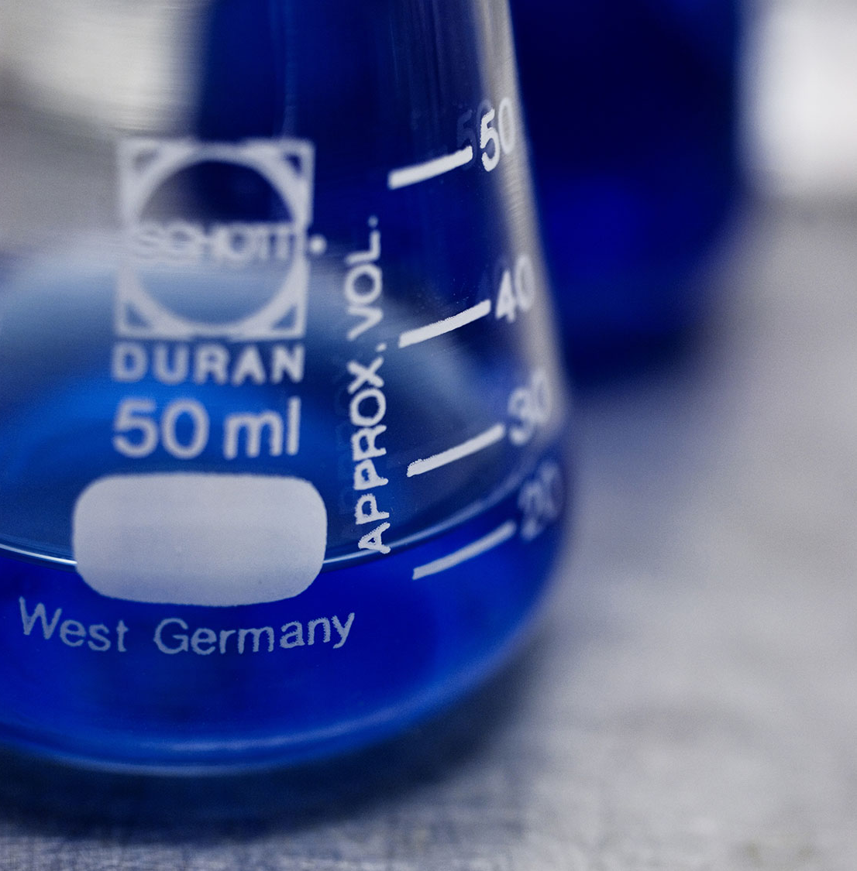
Research at Mid Sweden University
is partly organized in research centres and partly in subject research and research groups
is, to a great extent, conducted and made use of in direct collaboration with external partners
has a clear connection to first-cycle programmes and courses

Slide 23
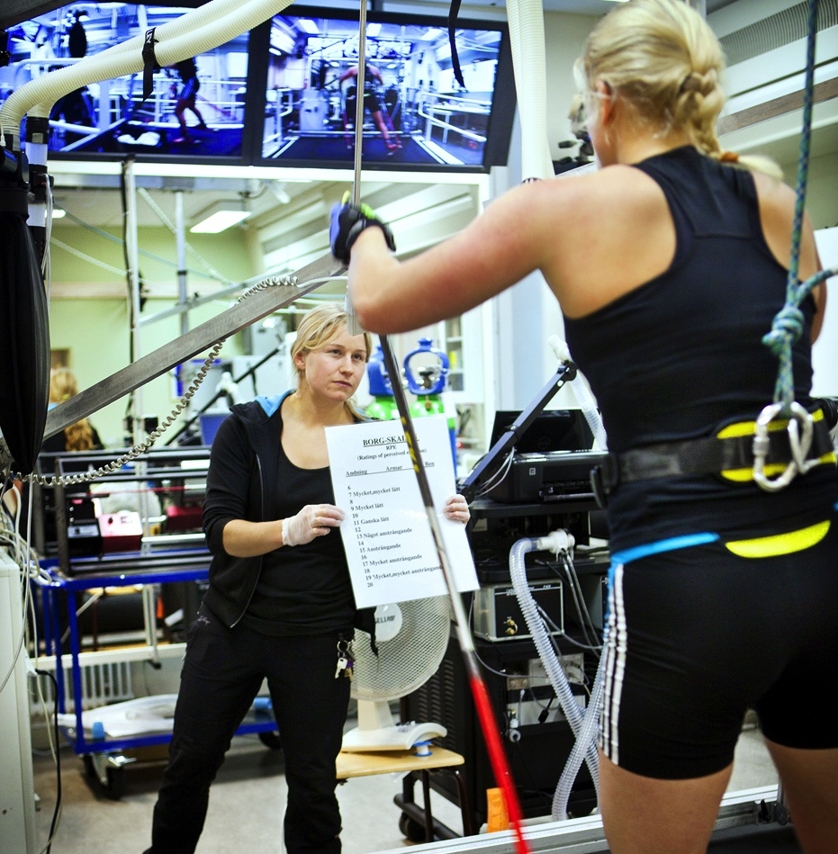
Profiled research areas
  Mid Sweden University has eight different research centres. They are the spearhead of our profile areas, but also platforms for cooperation with financiers and other parties.

Slide 24
Research centres
CER – conducts industry-oriented research on economic relations of individuals and companies in the banking, insurance, pension, audit and real estate industries
DEMICOM – conducts research on democracy and communication in the digital community
ETOUR – develops and communicates scientific knowledge about tourism and travel
FSCN – conducts world-leading research in collaboration with the industry in subprocesses from forest to paper, biomaterial and new products

Slide 25
Research centres
NVC – research in winter sports/skiing, performance and health
RCR – develops and communicates knowledge about risk, crisis and security
Sports Tech Research Centre – research in sports technology and products for outdoor and sports activities as well as products meeting the demands of people with disabilities
STC – develops sensor-based systems and services in electronics and computer science with a focus on industrial IT and digital services

Slide 26
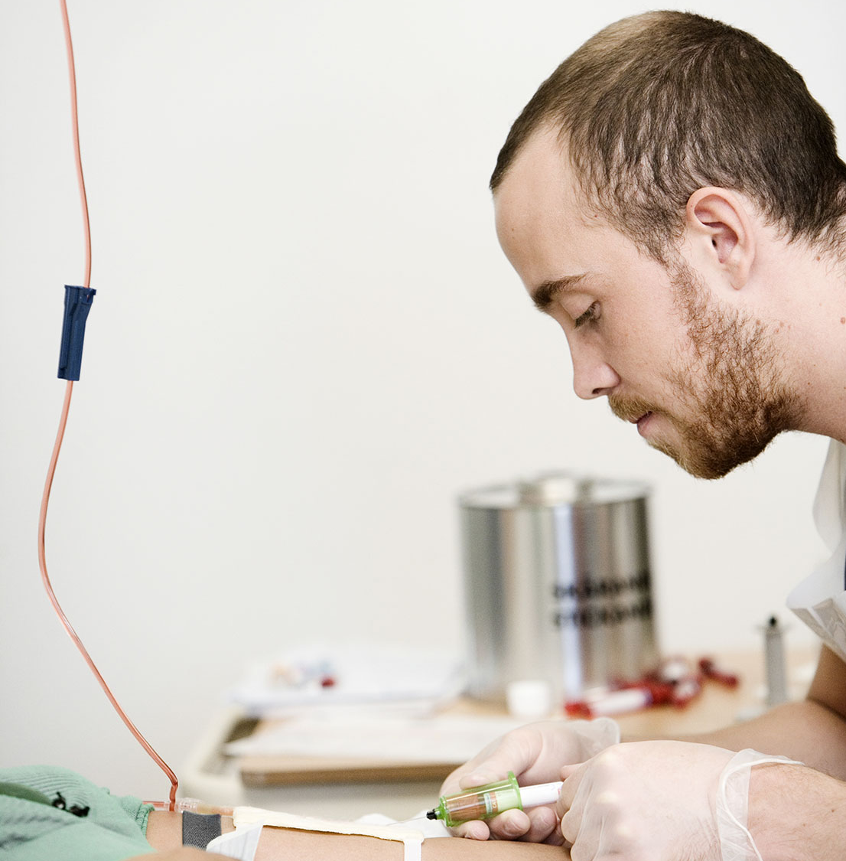
Subject research
Research connected to big and important
first-cycle educational areas
A great part of subject research deals with the welfare sector, for example school, care and nursing
Notes:
Subject research
Within Mid Sweden University, research is conducted in all scientific areas. This leads to a broad range of research projects and qualified researchers. One example is research related to big and important first-cycle educational areas. Since most researchers also teach, first-and second-cycle students get a natural insight into and a connection to the research conducted at Mid Sweden University in a certain subject.

Slide 27

Utilization of research
Innovation support for researchers
Commercialization of research and knowledge
Licensbanken – give away ideas and research results

Slide 28
Mid Sweden University 2016
– Infographics

Slide 29
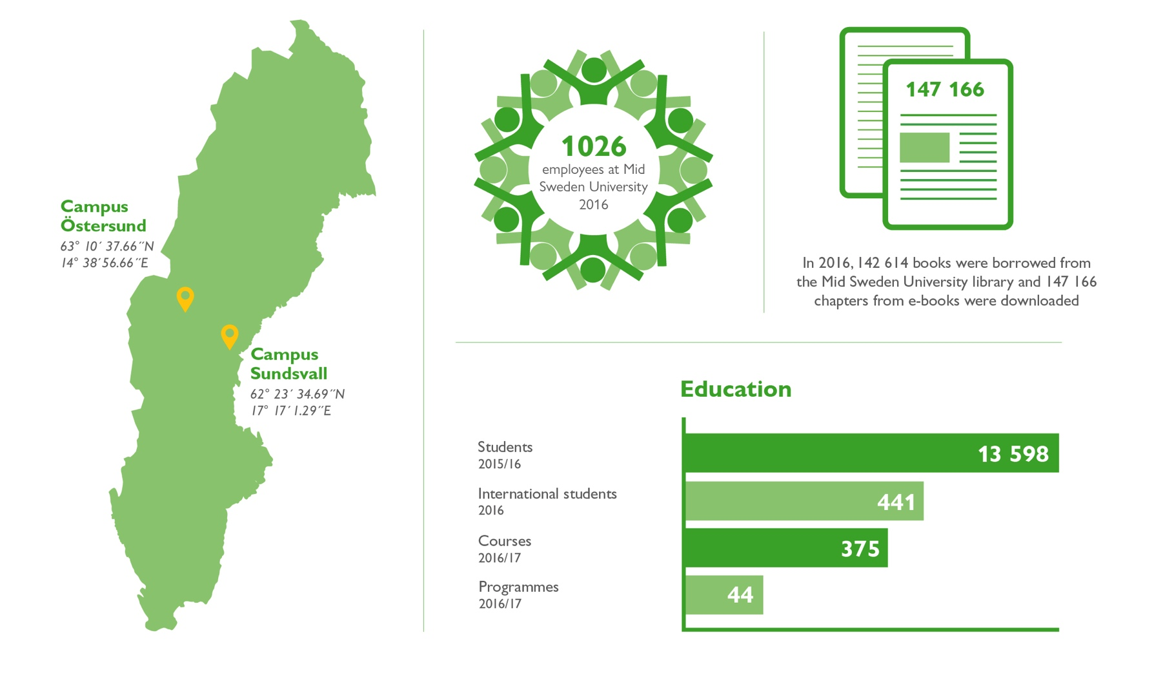

Slide 30
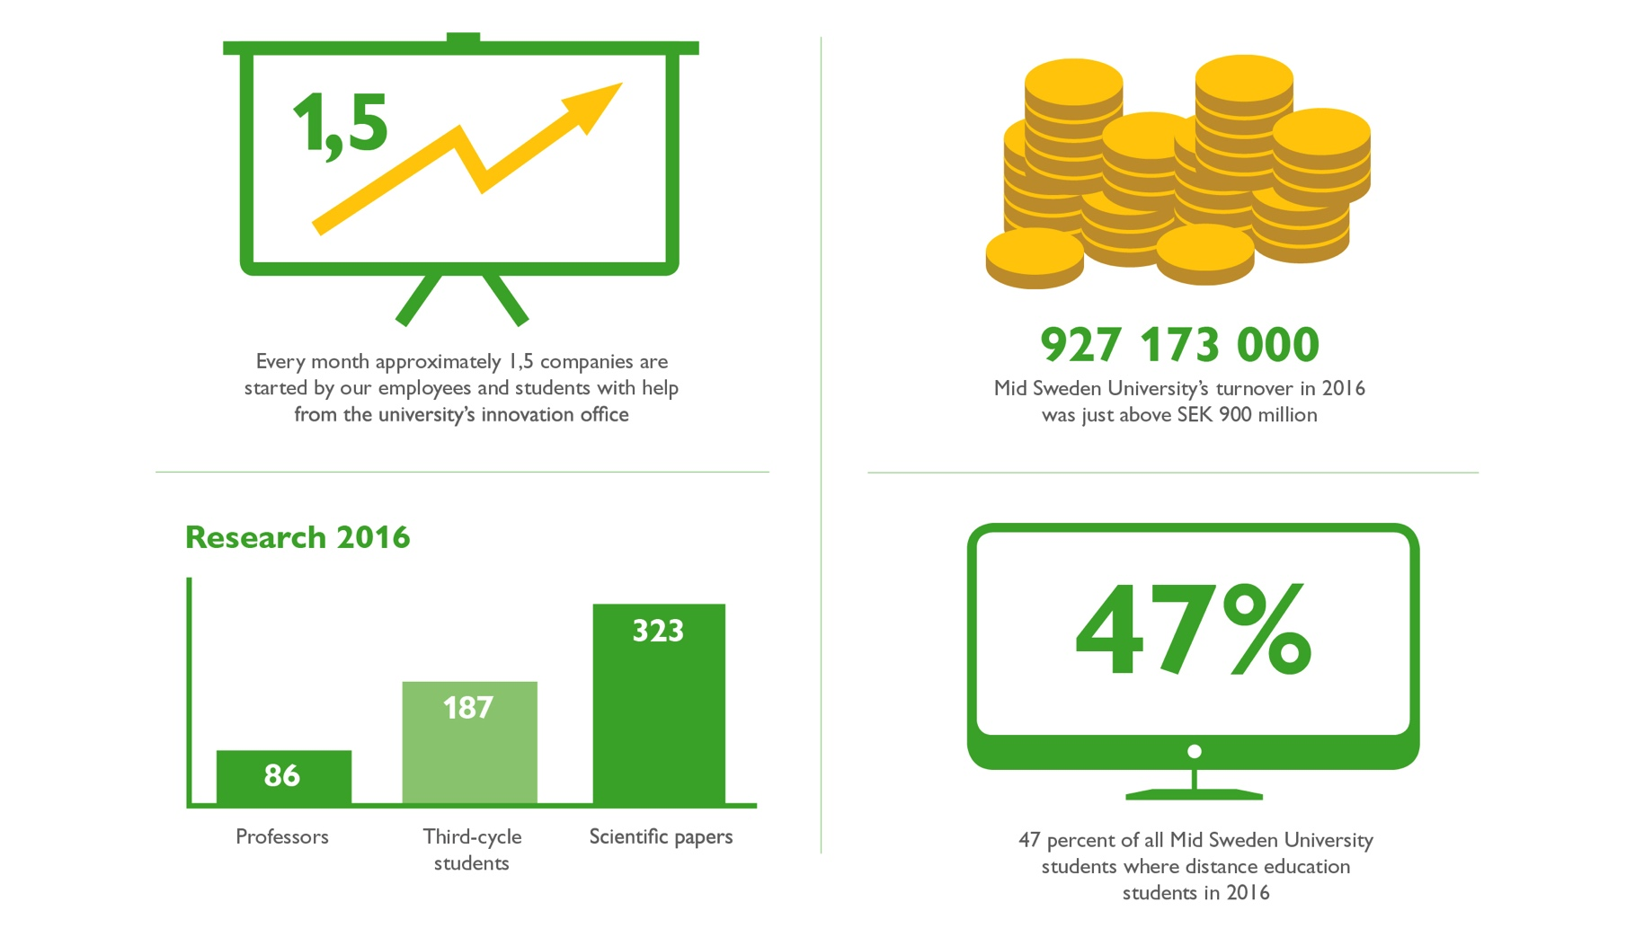

Slide 31
Contact
Phone +46 10 142 80 00
E-mail kontakt@miun.se
Web miun.se

