Slide 1
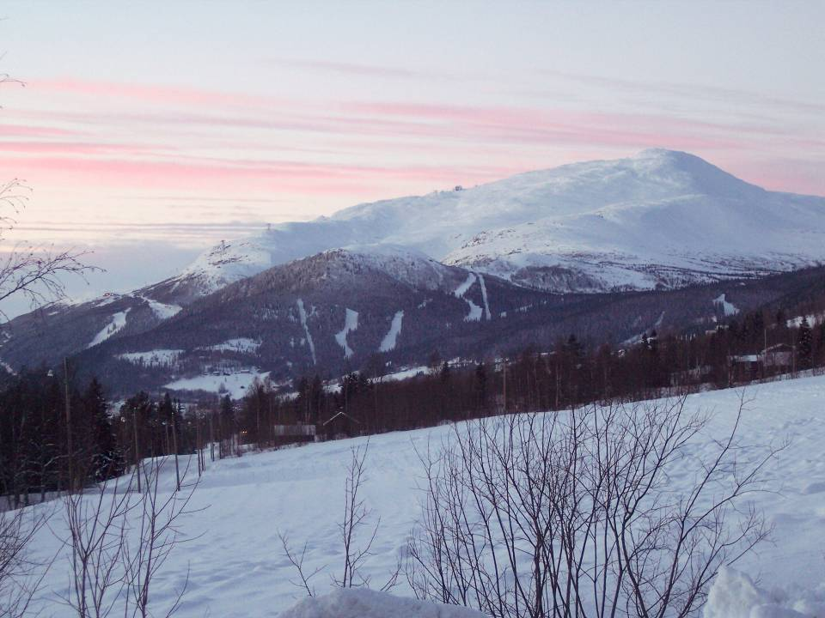
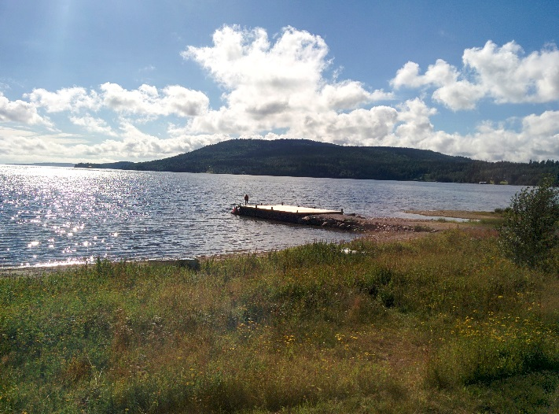
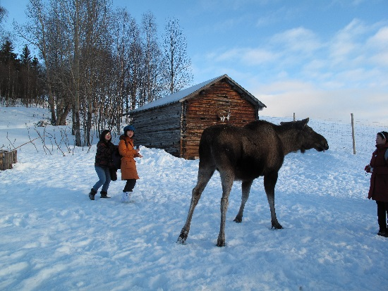
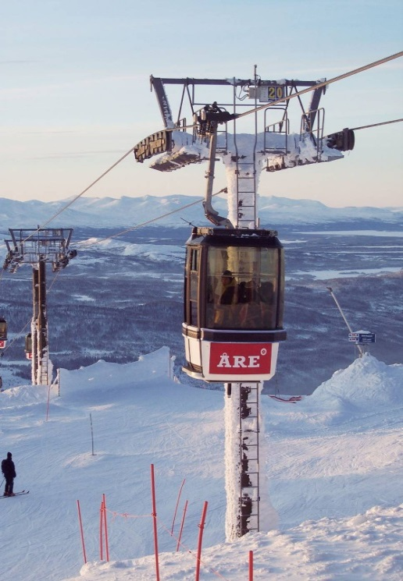
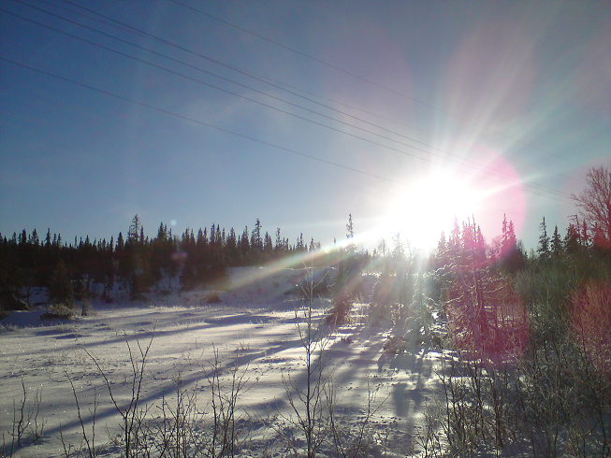
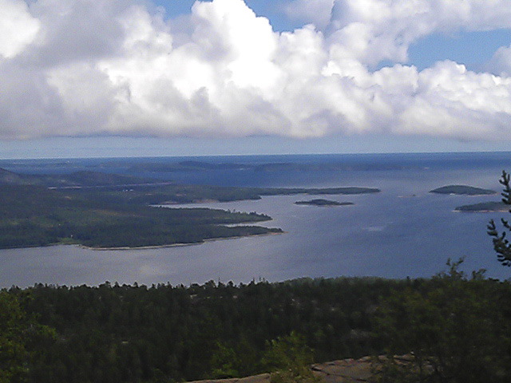
Mid Sweden University

Slide 2
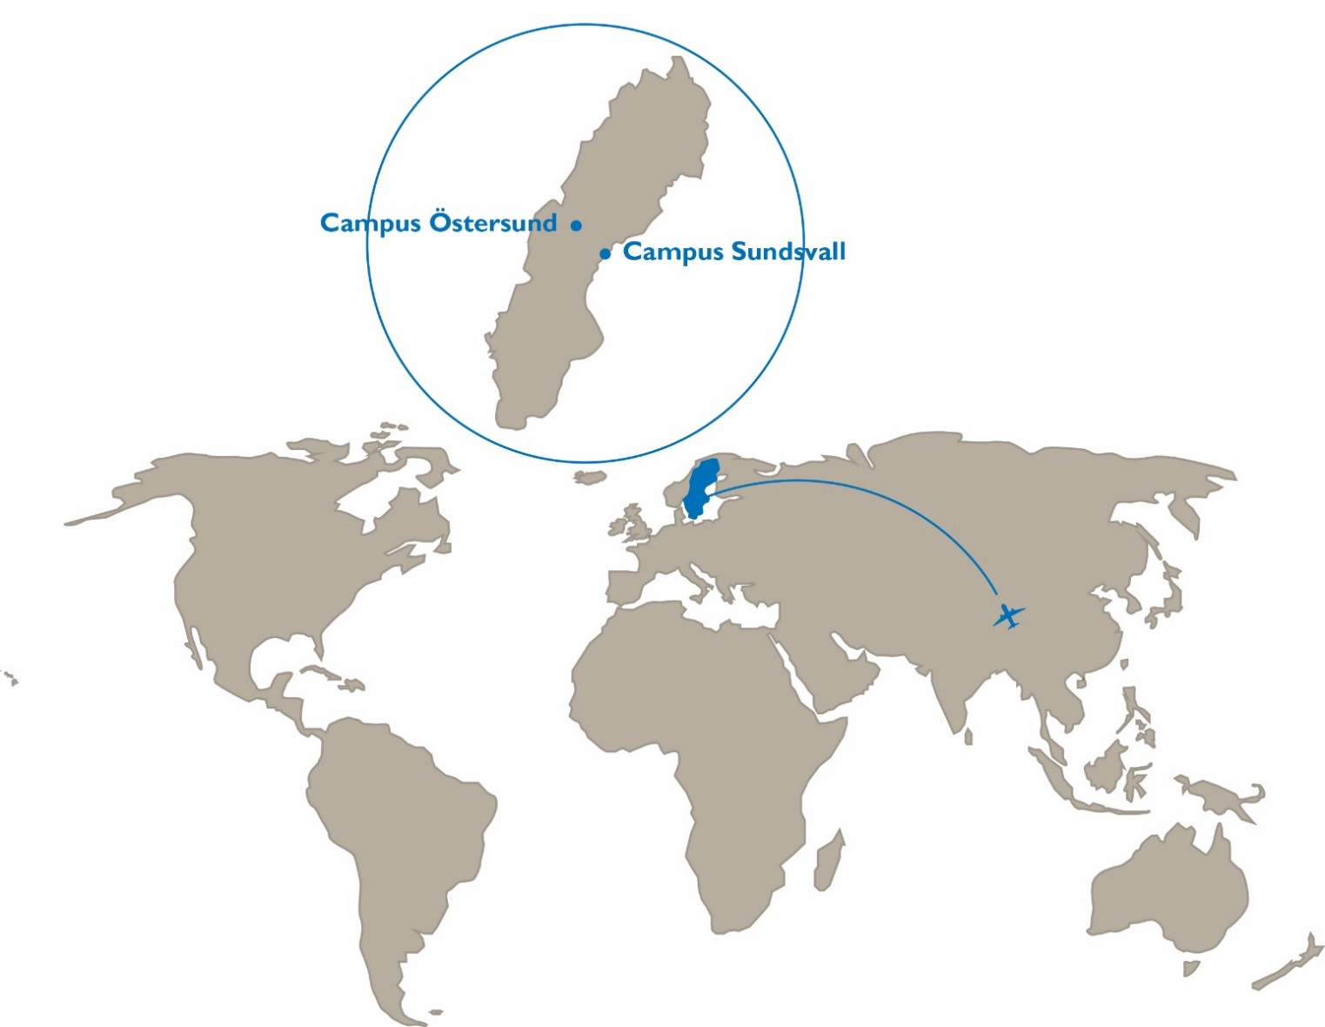
Mid Sweden University

Slide 3
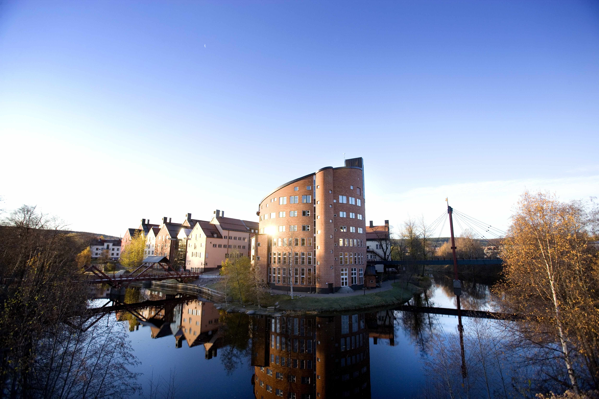

Sundsvall Campus
Notes:
Campus Sundsvall is situated a short walk from the centre of the city. It has lovely scenery, with leafy groups of trees
and a beautiful promenade along the river “Selångeersån.”
Campus Sundsvall won the Charter Award in 2005, which is one of the world’s most prestigious town architecture prizes, and that field’s equivalent of cinema’s Oscar Award.
Sundsvall is a well-reputed student city, in which the trade and industry, the municipality, and the university prioritise the students.
No less than four times since the year 2000, Sundsvall has been voted the most student friendly municipality in Sweden.
The city offers a great array of culture, entertainment, and shopping.

Slide 4
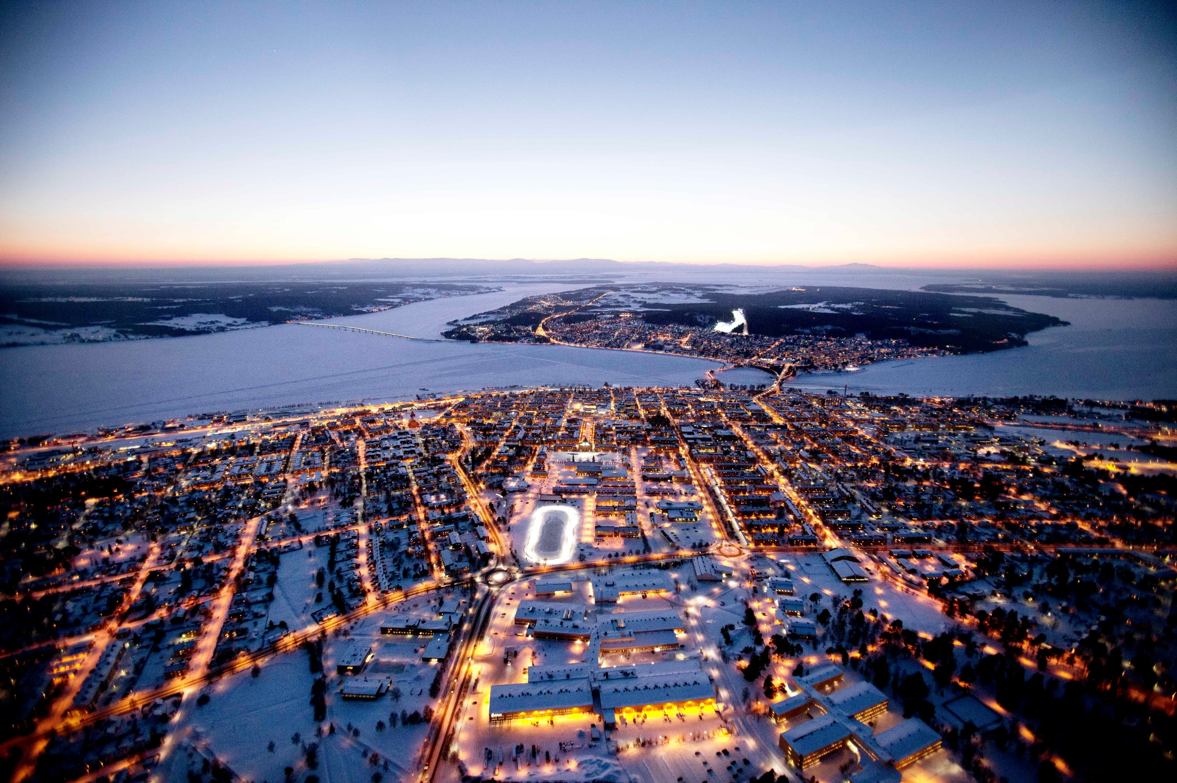
Östersund Campus
Notes:
Campus Östersund, inaugurated in 2002, is situated a few minutes walk from the
main shopping street in the centre of the city. The new city district with the university,
which formerly was a regiment, has been carefully renovated, built out, and
transformed into a welcoming campus. The area harbours a modern library, lecture halls,
student restaurants, and a café.
Östersund is the number one winter city. The short distance to the mountains and the
country’s top down hill centre “Åre” make many students choose Östersund as their city of studies.
The city and its surroundings have a wide range of recreational activities to offer the year around.

Slide 5
Bachelor Programmes Master Programmes
Ecotechnology
Computer Engineering
Ecotechnology and Sustainable Development
Embedded Sensor Systems
Tourism
Business Administration (one year)
Sports Science - Performance Optimisation with a Focus on Elite Sport (one year, distance)

Slide 6
Master by Research – Project-based Programme
Biology
Chemical Engineering
Chemistry
Computer Engineering
Electronics
Engineering Physics
Enivronmental Science
Media and Communication Science

Slide 7

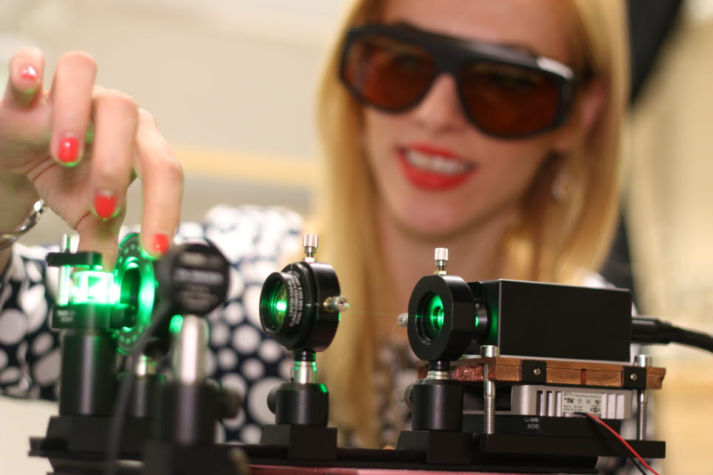

High quality education with strong connection to research and society
”At Mid Sweden University, we have very good research teams and the teachers are alwas available to help you expand your knowledge” An Siwen , China

Slide 8
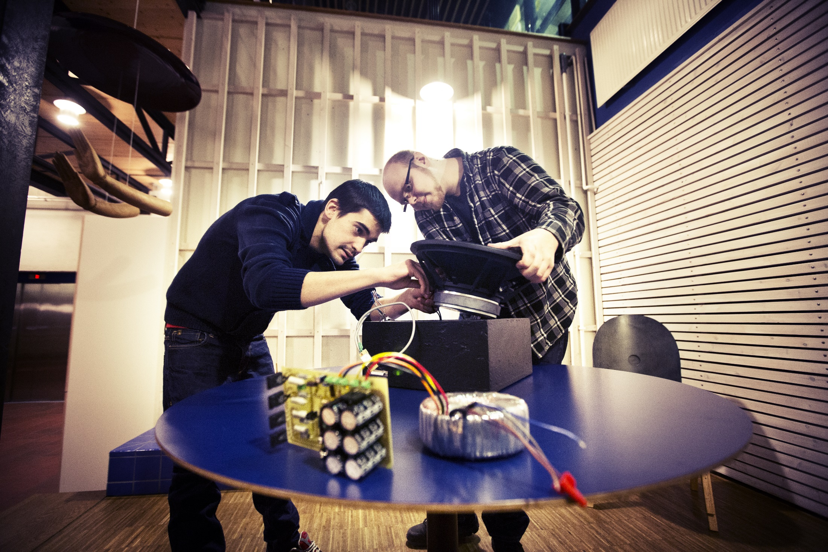
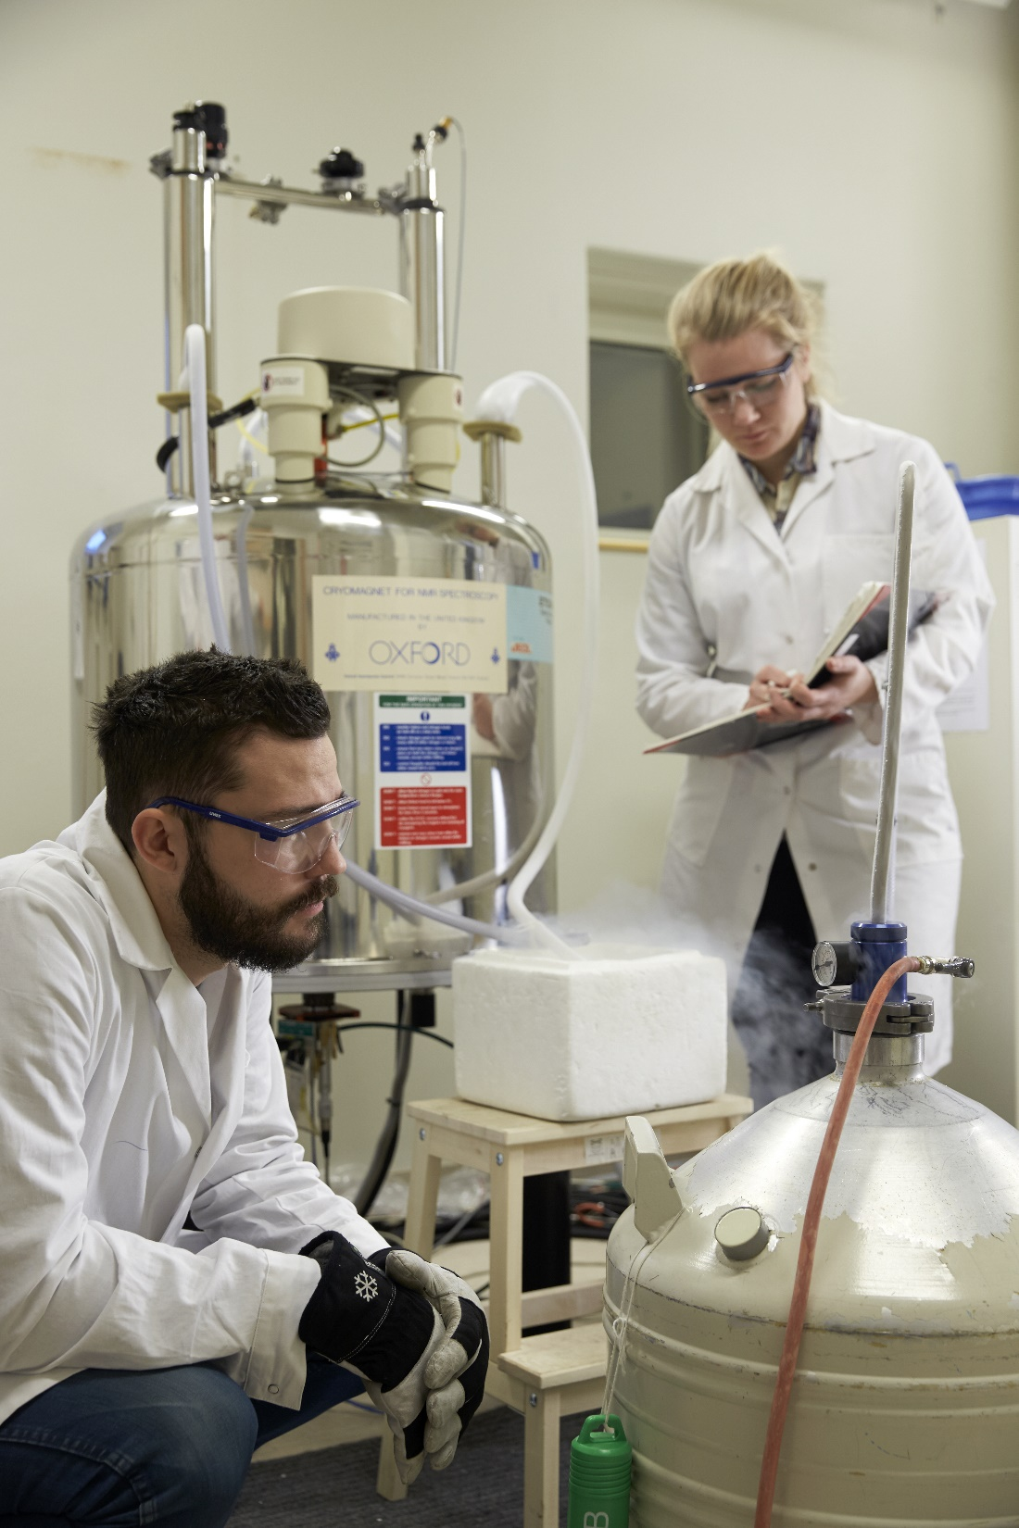
Research-oriented education
”Working in an international team of Master and PhD students closely together with your professors, gives you the opportunity to also learn about other fields and topics.” – Tomas, Switzerland

Slide 9
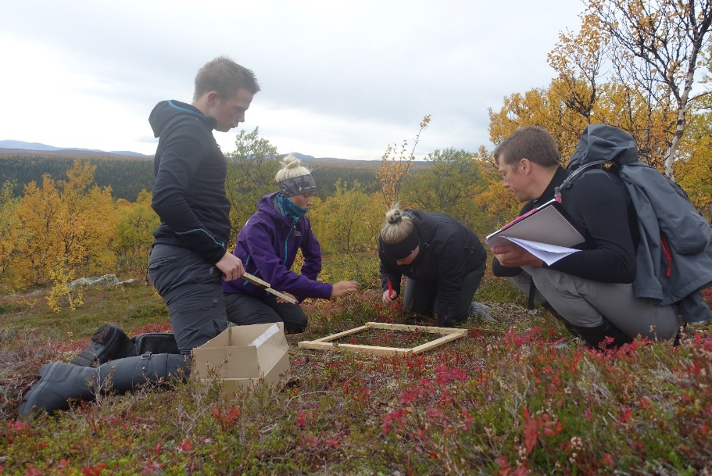
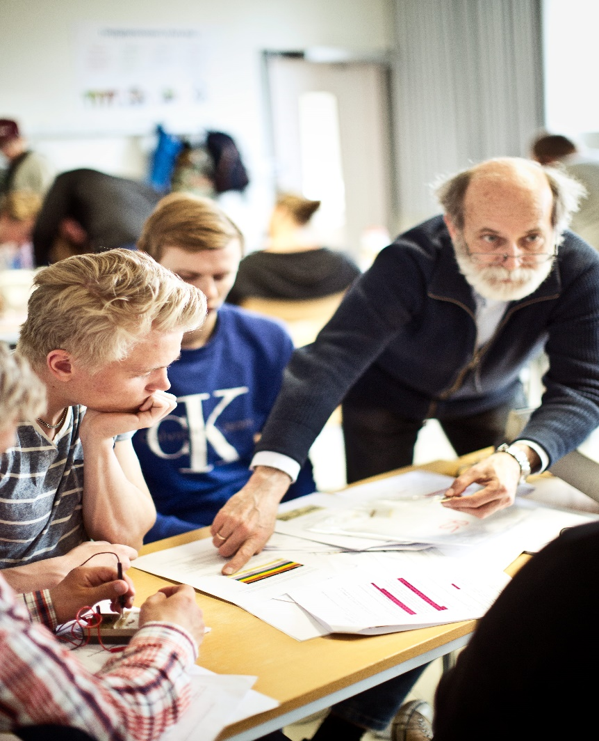
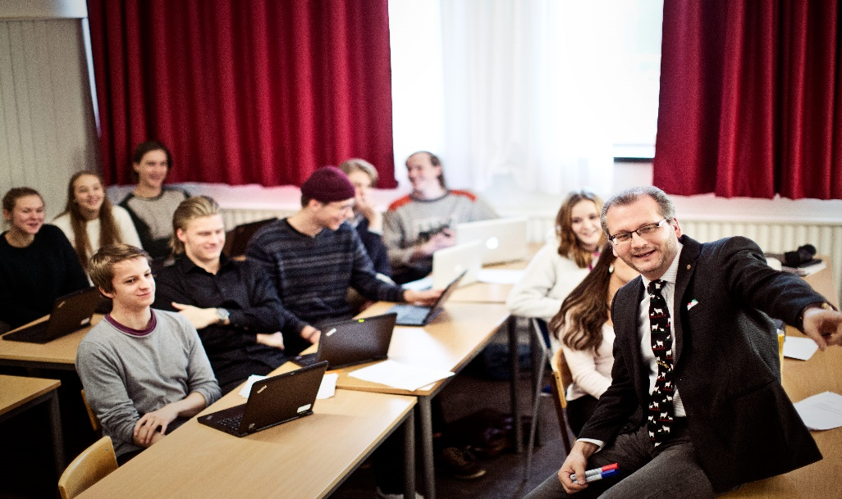
Small classes and accessible teachers
”The lecturers know you by name and are always really willing to help out and give you the individual advice and help that you need to succeed in your studies.” – Judith, UK

Slide 10
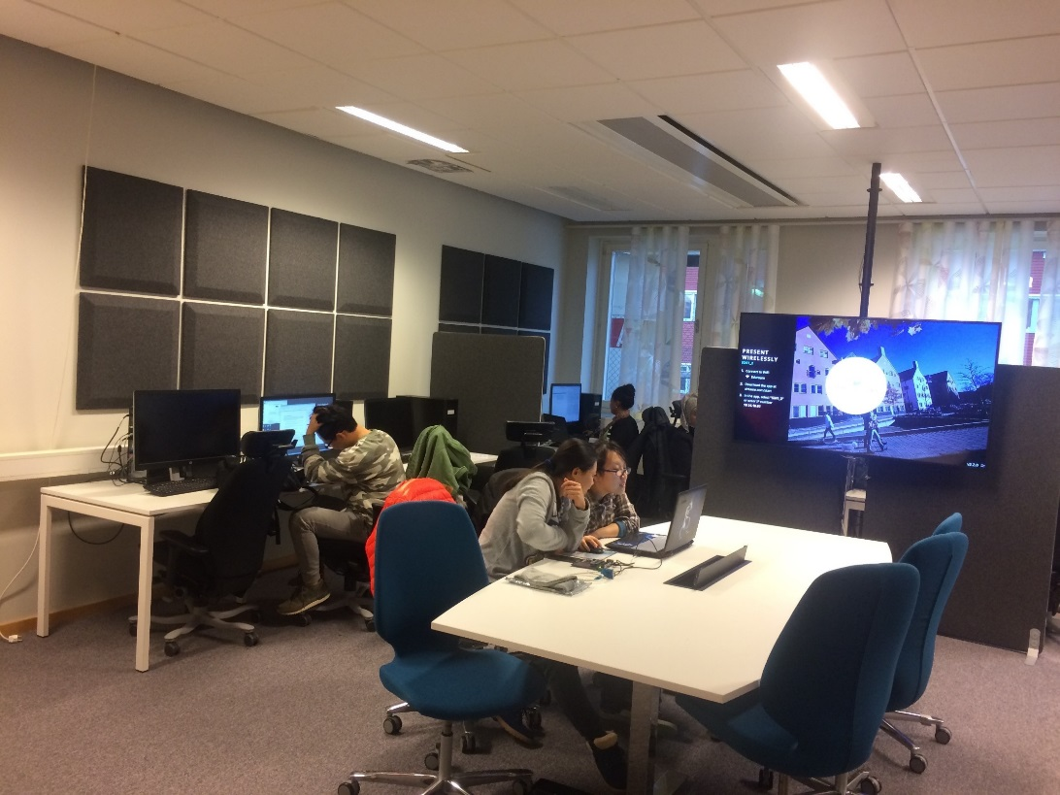
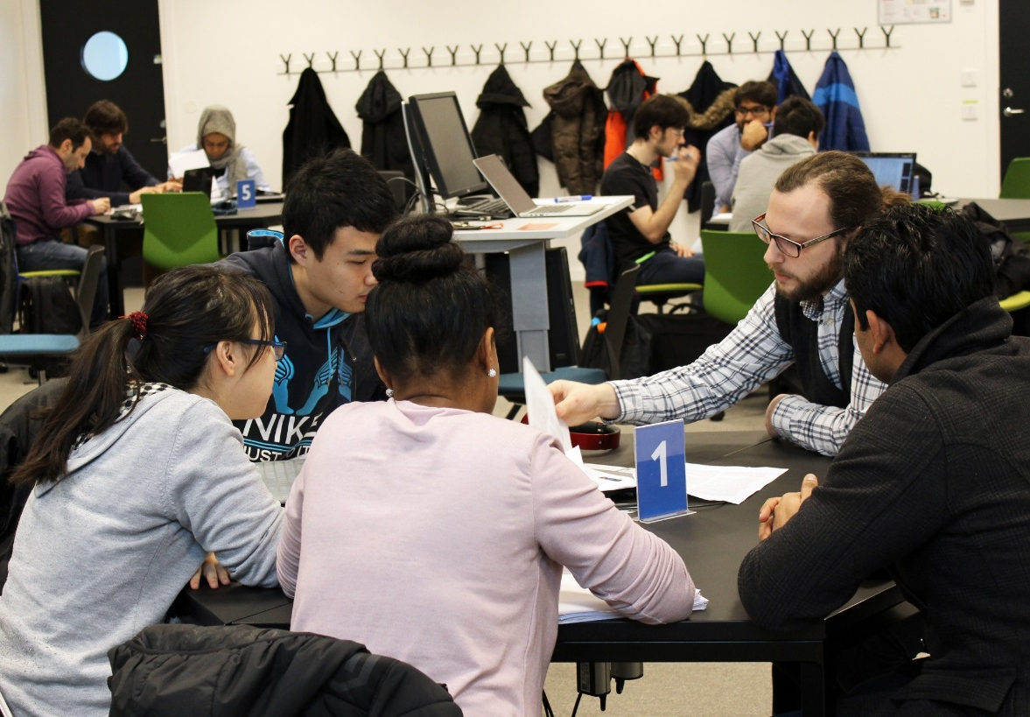
First-class facilities and high-tech equipment
”The campus is well equipped with labs and study rooms.
The library is a good place to study as well” – Guillaume, France

Slide 11

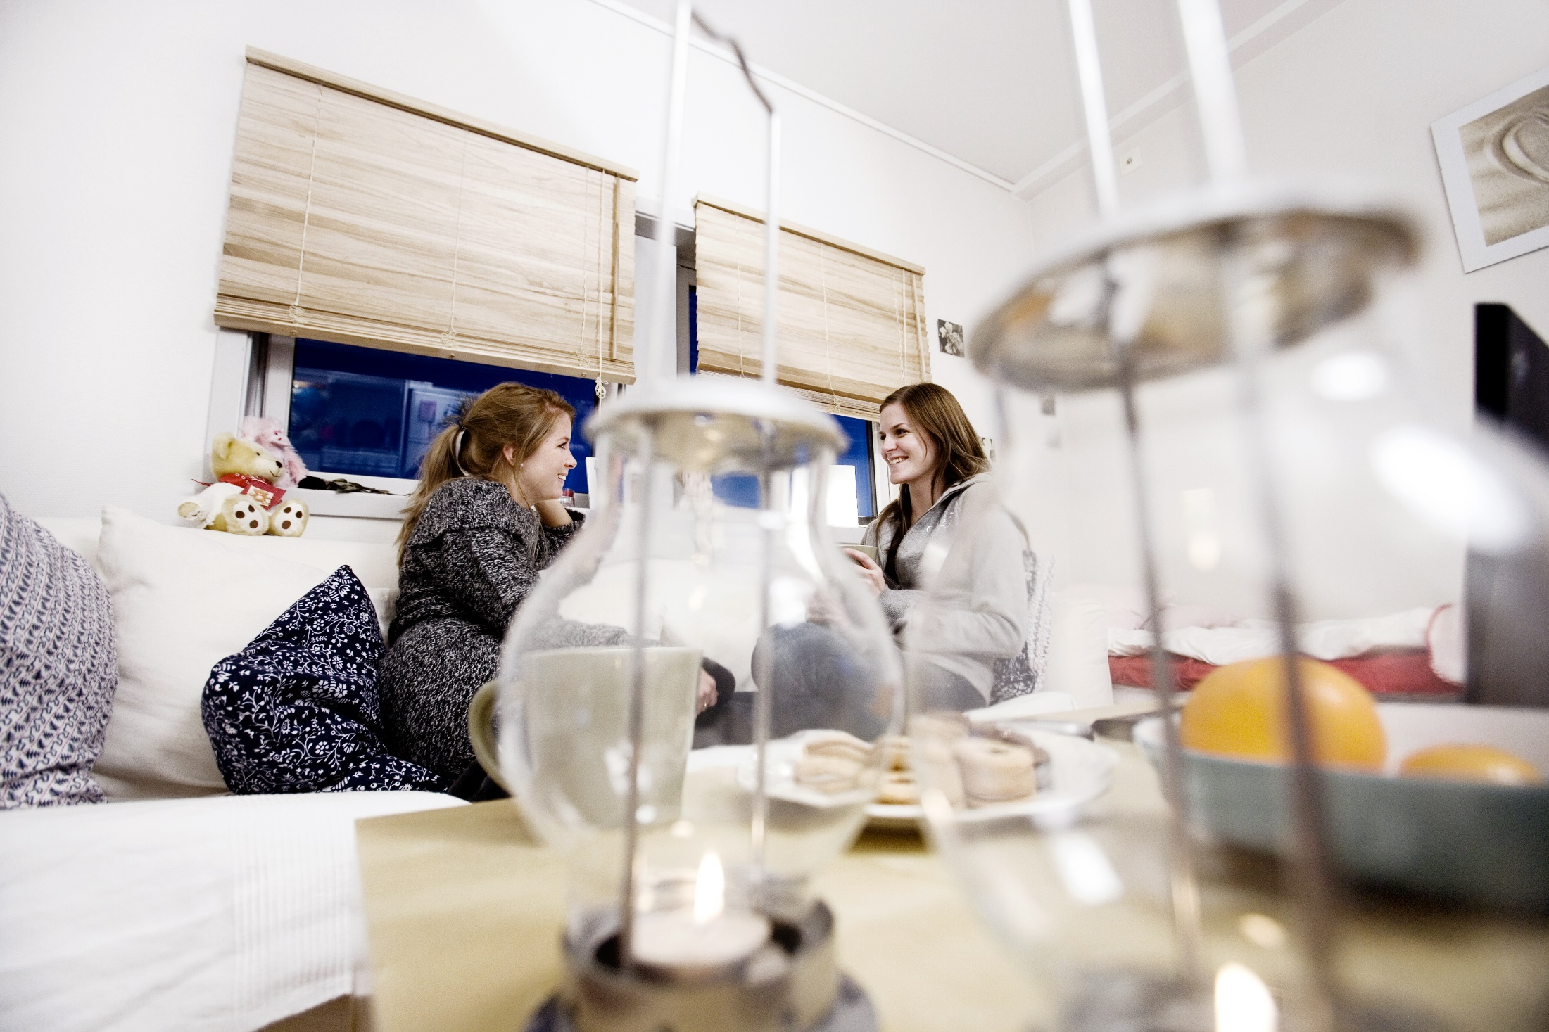
Student housing guarantee
”You get everything here – wild nature, real friends and a close student community” – Lesya, Ukraine

Slide 12
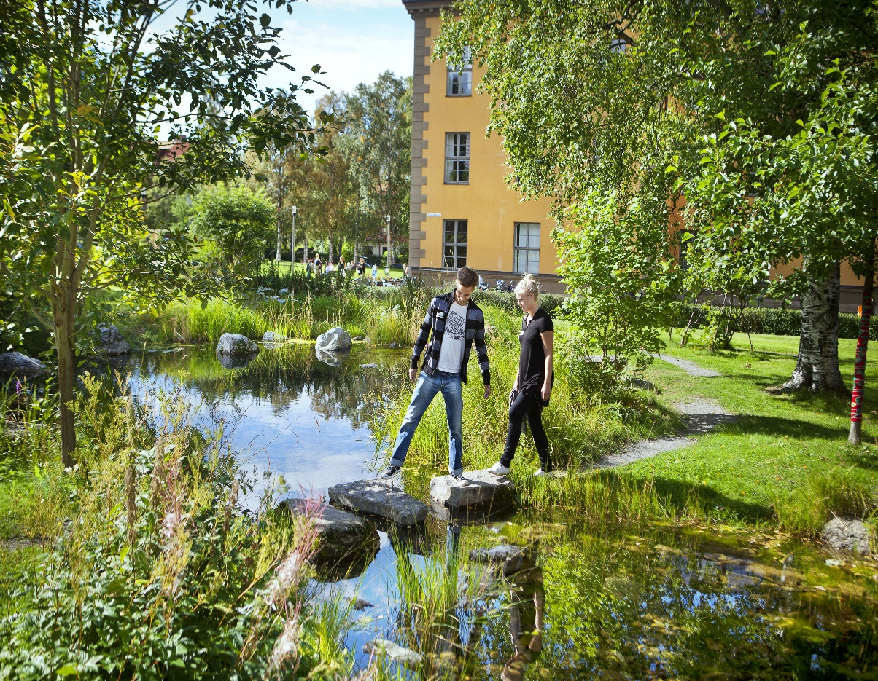
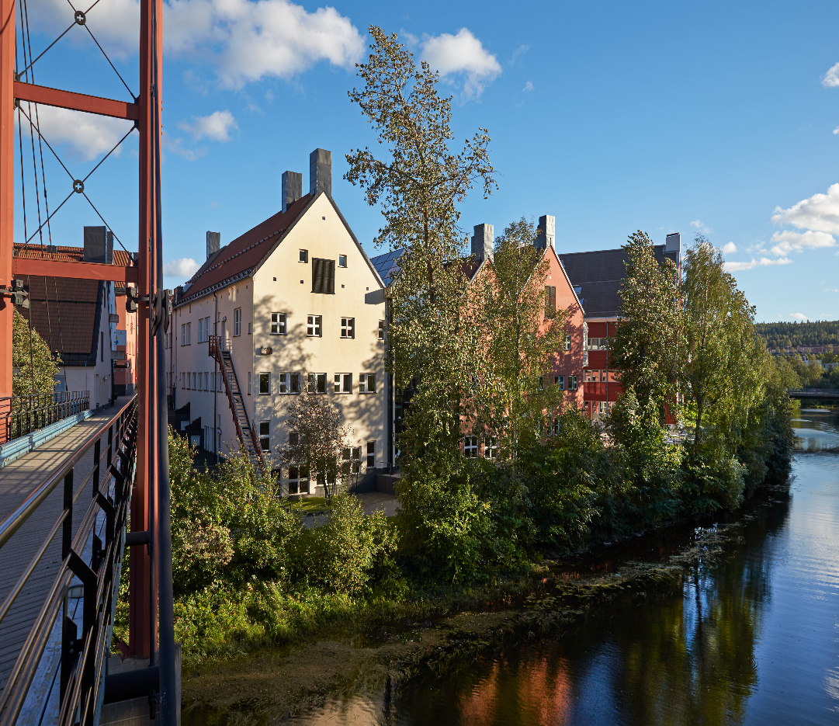
Ideal campus locations – close to city centre and nature
”Everything is surrounded by nature and you have the chance to see the northern lights!” – Melina, Germany

Slide 13
… more reasons
for studying at Mid Sweden University
24 hours access to facilities
Personal and caring environment
Swedish language courses for all international students
Easy access to nature - enjoy some of the best outdoor activities in Europe during all four seasons
”I really feel that I am building my future career here, it feels important and I get a chance to build a network as well” –
Meng Lie, China

Slide 14
English Language Requirements:
  IELTS: overall score of at least 6.5 and no section below 5.5
  TOEFL iBT: minimum score of 90 and not below 20 on the written test
Apply at www.universityadmissions.se by the 15th January 2019

Slide 15
Stay in touch! We hope that you will choose Mid Sweden University as your study destination and would be glad if you stay in touch with us on Facebook, Weibo, Wechat or by email for example. Follow us on Facebook!
For more information visit www.miun.se
or email us: internationaloffice@miun.se

Slide 17
For further information
Visit:
www.miun.se
www.miun.se/en/education/programmes/
www.miun.se/summeruniversity
www.miun.se/en/research
www.visitostersund.se
www.visitsundsvall.se

